Slide 1
Foundations of Information Systems in Business

Slide 2
Foundation Concepts
Why study information systems and information technology?
  Vital component of successful businesses
  Helps businesses expand and compete
  Improves efficiency and effectiveness of
  business processes
  Facilitates managerial decision making and workgroup collaboration
Chapter 1 Foundations of Information Systems in Business

Slide 3
What is a System?
A set of interrelated components
With a clearly defined boundary
Working together
To achieve a common set of objectives
Chapter 1 Foundations of Information Systems in Business

Slide 4
What is an Information System?
An organized combination of…
  People
  Hardware and software
  Communication networks
  Data resources
  Policies and procedures
This system…
  Stores, retrieves, transforms, and disseminates information in an organization
Chapter 1 Foundations of Information Systems in Business

Slide 5
Information Technologies
Information Systems
  All the components and resources necessary to deliver information and functions to the organization
  Could be paper based
Information Technologies
  Hardware, software, networking, data management
Chapter 1 Foundations of Information Systems in Business

Slide 6
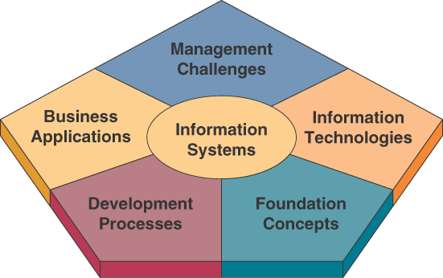
What Should Business Professionals Know?
Chapter 1 Foundations of Information Systems in Business

Slide 7
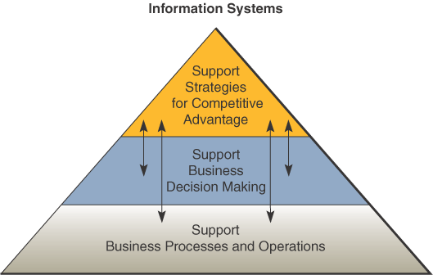
Fundamental Roles of IS in Business
Chapter 1 Foundations of Information Systems in Business

Slide 8
Types of Information Systems
Operations Support Systems
  Efficiently process business transactions
  Control industrial processes
  Support communication and collaboration
  Update corporate databases
Management Support Systems
  Provide information as reports and displays
  Give direct computer support to managers during decision-making
Chapter 1 Foundations of Information Systems in Business

Slide 9
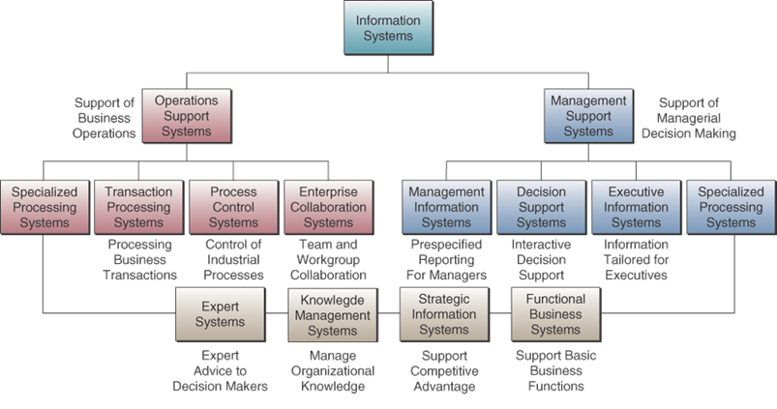
Purposes of Information Systems
Chapter 1 Foundations of Information Systems in Business

Slide 10
Operations Support Systems
What do they do?
  Efficiently process business transactions
  Control industrial processes
  Support communications and collaboration
  Update corporate databases
Chapter 1 Foundations of Information Systems in Business

Slide 11
Types of OSS
Transaction Processing Systems
  Record and process business transactions
  Example: sales processing, inventory systems, accounting systems
Process Control Systems
  Monitor and control physical processes
  Example: using sensors to monitor chemical processes in a petroleum refinery
Enterprise Collaboration Systems
  Enhance team and workgroup communication
  Example: email, video conferencing
Chapter 1 Foundations of Information Systems in Business

Slide 12
Two Ways to Process Transactions
Batch Processing
  Accumulate transactions over time and process periodically
  Example: a bank processes all checks received in a batch at night
Online Processing
  Process transactions immediately
  Example: a bank processes an ATM withdrawal immediately
Chapter 1 Foundations of Information Systems in Business

Slide 13
Management Support Systems
What do they do?
  Provide information and support for effective decision making by managers
    Management information systems
    Decision support systems
    Executive information systems
Chapter 1 Foundations of Information Systems in Business

Slide 14
Types of Management Support Systems
Management Information Systems (MIS)
  Reports and displays
  Example: daily sales analysis reports
Decision Support Systems (DSS)
  Interactive and ad hoc support
  Example: a what-if analysis to determine where to spend advertising dollars
Executive Information Systems (EIS)
  Critical information for executives and managers
  Example: easy access to actions of competitors
Chapter 1 Foundations of Information Systems in Business

Slide 15
Other Information Systems
Expert Systems - provide expert advice
  Example: credit application advisor
Knowledge Management Systems - support creation, organization, and dissemination of business knowledge throughout company
  Example: intranet access to best business practices
Strategic Information Systems - help get a strategic advantage over customer
  Example: shipment tracking, e-commerce Web systems
Functional Business Systems - focus on operational and managerial applications of basic business functions
  Example: accounting, finance, or marketing
Chapter 1 Foundations of Information Systems in Business

Slide 16
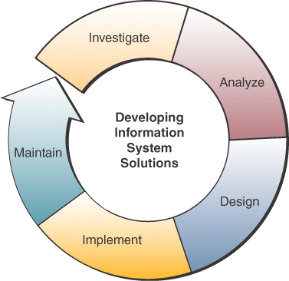
Developing IS Solutions
Chapter 1 Foundations of Information Systems in Business

Slide 17
The IS Function
The IS function is…
  A major functional area of business
  An important contributor to operational efficiency, employee productivity, morale, customer service and satisfaction
  A major source of information and support for decision making
  A vital ingredient in developing competitive products and services in the global marketplace
  A dynamic and challenging career opportunity
  A key component of today’s networked business
Chapter 1 Foundations of Information Systems in Business

Slide 18
What is a System?
A system is…
  A set of interrelated components
  With a clearly defined boundary
  Working together
  To achieve a common set of objectives
  By accepting inputs and producing outputs
  In an organized transformation process
Chapter 1 Foundations of Information Systems in Business

Slide 19
Basic Functions of a System
Input
  Capturing and assembling elements that enter the system to be processed
Processing
  Transformation process that converts input into output
Output
  Transferring transformed elements to their ultimate destination
Chapter 1 Foundations of Information Systems in Business

Slide 20
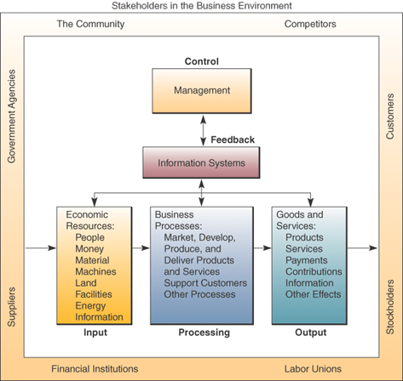
A Business as a System
Chapter 1 Foundations of Information Systems in Business

Slide 21
Other System Characteristics
If a system is one of the components of a larger system, it is a subsystem
  The larger system is an environment
Several systems may share the same environment
  Some may be connected via a shared boundary, or interface
Types of systems…
  Open
  Adaptive
Chapter 1 Foundations of Information Systems in Business

Slide 22
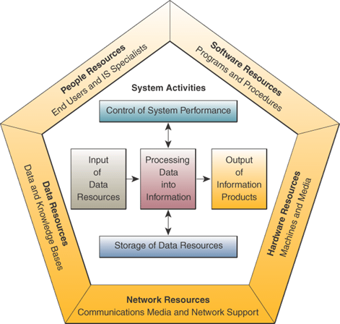
Components of an IS
Chapter 1 Foundations of Information Systems in Business

Slide 23
Information System Resources
People Resources
  Specialists
  End users
Hardware Resources
  Machines
  Media
Software Resources
  Programs
  Procedures
Data Resources
  Product descriptions, customer records, employee files, inventory databases
Network Resources
  Communications media, communications processors, network access and control software
Information Resources
  Management reports and business documents using text and graphics displays, audio responses, and paper forms
Chapter 1 Foundations of Information Systems in Business

Slide 24
Data Versus Information
Data are raw facts about physical phenomena or business transactions
Information is data that has been converted into meaningful and useful context for end users
Example:
  Sales data is names, quantities, and dollar amounts
  Sales information is amount of sales by product type, sales territory, or salesperson
Chapter 1 Foundations of Information Systems in Business

Slide 25
IS Activities
Input of data resources
  Data entry activities
Processing of data into information
  Calculations, comparisons, sorting, and so on
Output of information products
  Messages, reports, forms, graphic images
Storage of data resources
  Data elements and databases
Control of system performance
  Monitoring and evaluating feedback
Chapter 1 Foundations of Information Systems in Business

